Slide 1

Fundamental of Artificial Neural Network
Dr. Kumara Ari Yuana, ST., MT.

Slide 2
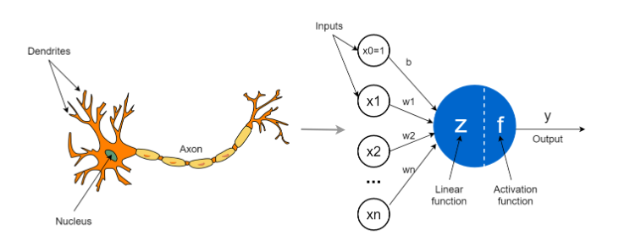
1. The Perceptron: The Biological Neuron Analogy
A mathematical model of a biological neuron.
Inputs (x₁, x₂, ...): Different factors influencing your decision (e.g., "Is it sunny?", "Do I have free time?", "Is the park nearby?").
Weights (w₁, w₂, ...): The importance you give to each factor (e.g., you care more about free time than sunshine).
Summation (Σ wᵢxᵢ): You calculate a weighted sum of all factors.
Bias (b): Your inherent tendency. A positive bias means you're naturally inclined to go out, even if factors are weak.
Activation Function (f): The final decision rule. A simple rule: if the total score is above a threshold, you GO; else, you STAY.
Mathematically:
output = f( w₁x₁ + w₂x₂ + ... + wₙxₙ + b )

Slide 3
2. Activation Functions: The Source of Non-Linearity
Why Non-Linearity Matters: Imagine we are trying to fit a curve to data points. A straight line (linear function) is often insufficient. Activation functions act as bends and twists, allowing the network to model any complex shape or function (this is formalized by the Universal Approximation Theorem).

Slide 4
3. Forward Propagation: Making a Prediction
This is the "forward pass" or inference step. It's how the network makes a prediction.
Process:
Input: You feed a data sample (e.g., an image's pixel values) into the input layer.
Layer-by-Layer Computation: The data flows through the network.
  For each neuron in the first hidden layer, compute the weighted sum of all inputs plus the bias.
  Apply the activation function to this sum. This becomes the neuron's output.
  This output is now an input for the next layer.
Output: The final layer produces the network's prediction (e.g., "85% probability this image is a cat").
Analogy: A factory assembly line. Raw materials (input data) enter, get processed and transformed at each station (layer), and a finished product (prediction) comes out.
Key Insight: Forward propagation is just a series of matrix multiplications and element-wise applications of the activation function. It's fast and deterministic.

Slide 5
4. Loss Functions: The Measure of "Wrongness"
Task | Common Loss Function | Explanation
Binary Classification | Binary Cross-Entropy | Measures the distance between two probability distributions: the predicted probability and the true label (0 or 1). Punishes confident wrong answers severely.
Multi-Class Classification | Categorical Cross-Entropy | The generalization for multiple classes. Used when the output is a probability distribution over several classes (e.g., cat/dog/horse).
Regression (predicting a number) | Mean Squared Error (MSE) | The average of the squares of the errors (difference between prediction and true value). Punishes large errors more heavily.
Insight: The choice of loss function is critical because it defines what "success" means for your model. A model optimized for MSE will behave very differently from one optimized for Cross-Entropy, even on the same data

Slide 6
5. Backward Propagation (Backpropagation): The Learning Algorithm
This is the magic that makes neural networks learn. It's an efficient application of the chain rule from
calculus to compute the gradient of the loss function with respect to every weight in the network.
The Goal: Answer the question: "How much did each weight contribute to the final error?"
The Process (Simplified):
Forward Pass: Run input through the network to get a prediction. Calculate the loss.
Initialize Gradient: Calculate the gradient of the loss with respect to the network's output. This is the starting error signal.
Backward Pass (Layer-by-Layer):
  Work backwards from the output layer to the input layer.
  For each layer, use the chain rule to compute two things:
  a) The gradient of the loss with respect to the layer's weights (∂Loss/∂W). This tells us how to change the weights to reduce the loss.
  b) The gradient of the loss with respect to the layer's input (∂Loss/∂X). This becomes the error signal that is passed backward to the previous layer.
Weight Update: Once we have the gradient for all weights (∂Loss/∂W), we use an optimizer (like Gradient Descent) to update them:
W_new = W_old - learning_rate * (∂Loss/∂W)

